Slide 1

Sunflower (PMP M80) Project Open Stage Gate Department: Plant Solution Control SG Date: 25/01/2013
Notes:
Template of Project report in PSC for PPR (Project Progress Review)

Slide 2
Marketing Leo Wang

Slide 3
What is CSP
Concentrating Solar Power (CSP) technology uses reflective materials to concentrate the sun heat to drive a conventional power cycle.
Current technology of CSP
Parabolic trough - Commercially proven
Solar power tower – Pilot commercial
Fresnel reflectors - Pilot
Dish Stirling - Demonstration
Source: IRENA reports – Renewable energy technologies: cost analysis series – Concentrating Solar Power
Tower
Parabolic

Slide 4
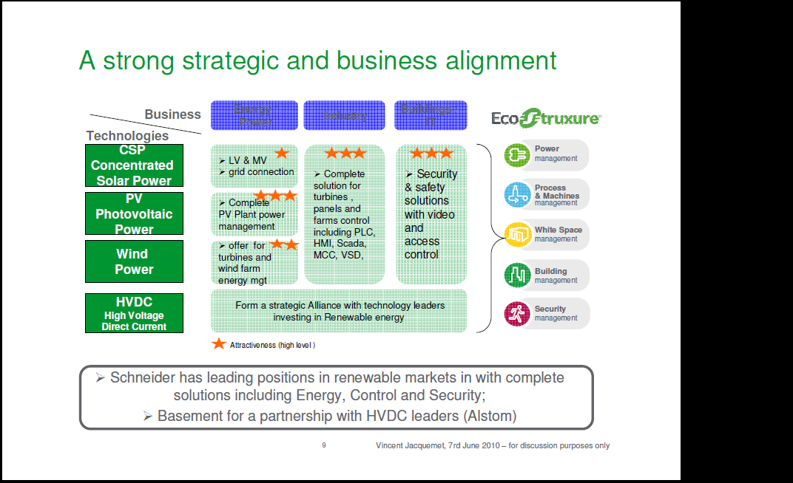
Business
Fit SE and Plant solution

Slide 5
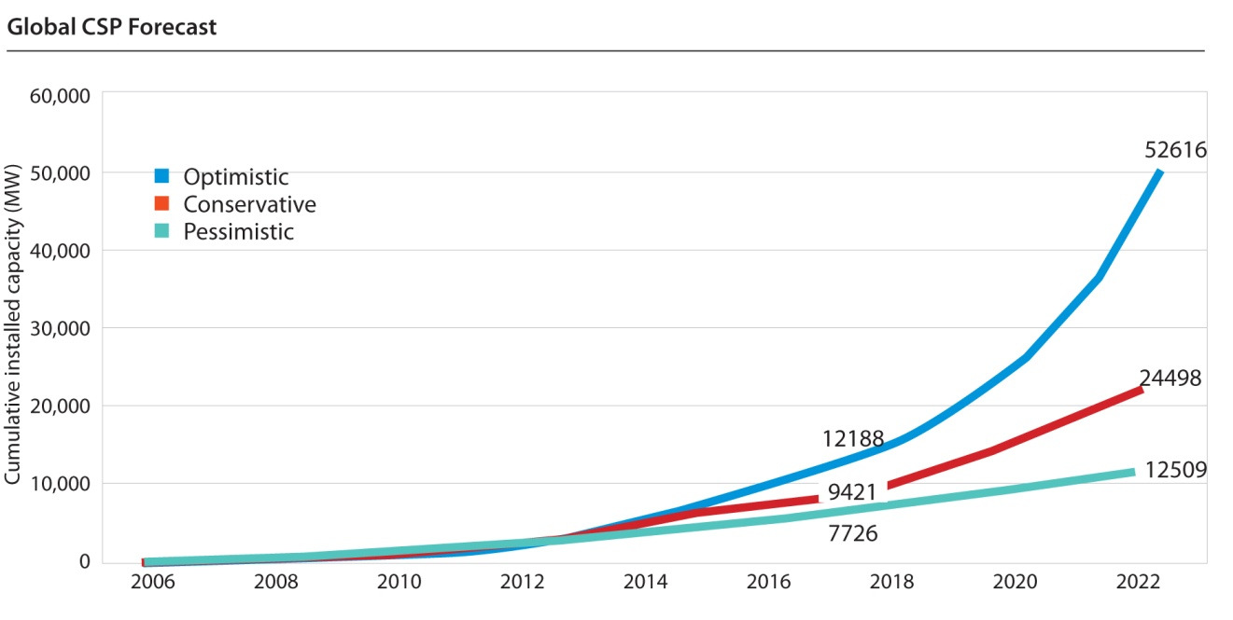
Business
Booming CSP market
M80 delivery
Source: 2012 CSP INDUSTRY MARKET FORECAST AND OUTLOOK of CSP Today

Slide 6
Business
Strong partnership
There are 2 major EPCs in CSP market that SE has accessed, Sener (30%) and Abengoa (70%).
Sener is a historical SE customer which promotes PlantStruxure Ethernet solution. This is our primary target for M80.
Abengoa is a historical Telvent customer which promotes a solution very different to PlantStruxure Ethernet solution. It’s expected that Abengoa will in the mid term move toward PlantStruxure Ethernet solution.
Example of operating plants
For Sener: Gemasolar CSP tower project and several CSP parabolic projects
For Abengoa: 3 CSP tower projects (PS10 : 11 MW, PS20: 20 MW, Eureka) and tens of CSP parabolic projects are in operation.
Now we have many CSP projects in pipeline
More projects with over 20,000 PLC consumption in 2 years.

Slide 7
Origin of the Offer
The origin of this project is to provide a just-enough Unity PAC (M340 is considered too expensive when facing competitors’ challenge) for booming CSP market
Currently, the CSP market is not mature; all the CSP projects need strong financial support of government. But the government subsidies are just short term solution, eventually the cost/watt of CSP need to become competitive in the market.
As CSP technology becomes mature and commercial, the customer will be more sensitive for the project cost.
With M80, we will keep our leading position in CSP market in both automation technology and project cost.
Customer will benefit from EU advantage of this M80 offer, such as Unity pro support, full PlantStuxure architecture, EU robustness, etc.

Slide 8
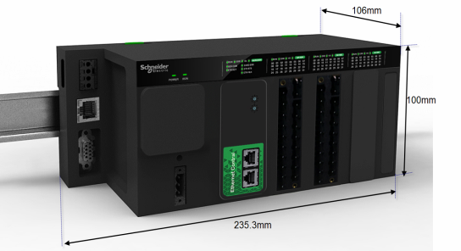
Offer Definition
2 new Compact CPUs (Part number and product family TBC)
Communication
Upstream:
2 Ethernet ports (1 MAC)
Downstream:
1 MB master,
1 CANopen master
Terminal:
1 USB device
Power supply
Embedded 24VDC
Embedded IO
BOX1: 8DI, 8DO, 2HSC
BOX2: 8DI, 8DO, 2HSC and 4AI
SD card& USB
Module and IO Status indicators
Serial Link
CANopen link
Power supply
Ethernet w/ embedded switch
IO boards
→ The only difference between box1 and box2 is integrated analog input channels.

Slide 9
Marketing Position
Targeted Application
Concentrated Solar Power (Parabolic through and Tower technology)
Other applications - TBC
Country ranking
Spain
USA
South Africa
India
Other countries
Currently, M80 is a dedicated controller for CSP application. It is considered as an optimized and compacted M340, which is tailored to provide just enough performance and functions.
→ In long term, M80 (if it becomes a new PAC range) will fill the gap of Plant solution PAC portfolio for small configuration.

Slide 10
Marketing Goal
Offer an cost effective Unity controller for CSP application
The controller will provide just enough function and performance for current and near future CSP application
Offer a step-wise approach to fill the entry level of the PlantStruxure range of controllers (If we choose to enlarge M80 platform as a new entry level Unity controller platform)

Slide 11
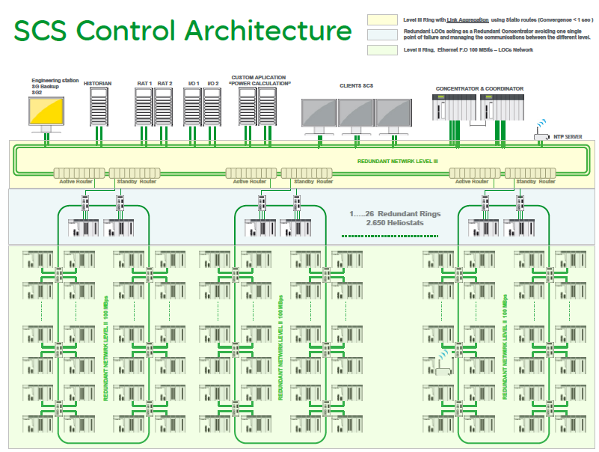

Slide 12


Proposed Architecture
SCS level
Full Ethernet architecture
Redundant copper ring in device level
Maximum 40 devices per sub ring (2 M340 with BMXNOC, 38 M80 controllers) * M340 – Memory size and ETH services
VRRP layer III
VRRP layer III
DRS
DRS
RSTP ( max 40 devices, copper or F.O)
RSTP 1 Primary Ring
DRS
DRS
DRS
DRS
DRS
DRS
M340 + NOC
M340 + NOC
M340 + NOC
RSTP 2 Secondary Ring
RSTP ( max 40 devices, copper or F.O)
RSTP ( max 40 devices, copper or F.O)
RSTP ( max 40 devices, copper or F.O)
RSTP ( max 40 devices, copper or F.O)
RSTP 3 third Ring
RSTP 4 fourth Ring
M80
M80
M80
M80
M80
M80

Slide 13
Cost Comparison and UVP
Cost Comparison
UVP
Entry level Unity controller that provide just enough function/performance for CSP application
Fully integrated in PlatStruXure
Cost effective → Save 349€ after weighting in each configuration
EU level robustness and reliability
CSP Configuration | 8 Dig in, 8 Dig out, 2 EHC | 8 Dig in, 8 Dig out, 2 EHC and 4 Ana in
M80 Reference cost (COGS) | 145€ *BMKC18332F BMXFTB2020 BMXFTB2820 | 176€ *BMKC18332F4M BMXFTB2020X2 BMXFTB2820
M340 Reference cost (COGS) | 479.25€ *BMXCPS2010,BMXXTSCPS10 BMXP3420102,BMXEHC0200 BMXXTSHSC20,BMXDDM16022 BMXFTB2020,BMXXBP0400 BMXNOC0401,BMXRMS008MPF | 548.74€ *BMXCPS2010,BMXXTSCPS10 BMXP3420102,BMXEHC0200 BMXXTSHSC20,BMXDDM16022 BMXFTB2020X2,BMXXBP0600 BMXAMI0410,BMXNOC0401, BMXRMS008MPF
Delta Cost | 334.25€ 69.7% | 408.74€ 67.9%

Slide 14
Competition
In CSP application, SE can provide very complete control system solution, include SCS, DCS, Medium Voltage Devices, Low Voltage Devices and Active filters. And with partner Sener and Abengoa, SE can deliver complete turnkey solution for CSP plants and provide consultant and service.
Our competitors mainly focus on CSP parabolic market now. They don’t provide equivalent solution as SE in CSP Tower market.
ABB
ABB with its technology partner Novatec Solar, delivers a complete turnkey solution comprising solar boiler, solar field, power block (including turbine, air condenser, electrical generator, pumps, all thermal cycle exchangers and piping), electrical balance of plant, plant automation system and grid connection.
They provide AC-500eCo PLC and inverters for tracking.
→http://www.abb.com/industries/us/9AAC166917.aspx
Siemens
Siemens provides some components of CSP plants, including boiler, turbine, generators. As for tracking, they offer S7-1200 as controller.
→http://www.energy.siemens.com/mx/en/power-generation/power-plants/csp-power-block/
Rockwell
Allen Bradley only provides a solution of control system, including Contrologix and Micologix.

Slide 15
Sales Forecast & ASP
SE sell M80 in the package of CSP project, normally no break down price for each product.
Here we set NSP of M80: 350€, it is an estimated price of M80 controller only. There is not split price for each reference
→ Separated NSP to be defined before DO
With M80, SE will defend current market share and keep same growth rate as CSP market
Forecast in quantities
Sener mainly
Sener + Abengoa
Year | 2014 | 2015 | 2016 | 2017 | 2018 | 2019
Units | 10,000 | 20,000 | 30,000 | 50,000 | 80,000 | 120,000

Slide 16
Summary – SENER projects
Project name | Country | Type/power | M80 qtties | Proba success w/ M80/M340/Other | Cost saving w/ M80 | Decision date | 1st M80 del date
Pedro Valdivia | Chile | Para 360MW | 1200 | 65%/10%/35% | 396 K€ | Q1 2013 | Q4 2013/Q1 2014
Ouarzezate | Morocco | Para | 1200 | 65%/10%/0? | 396 K€ | Q2 2013 | Q4 2013/Q1 2014
ARGELIA | Algeria | Tower 50MW | 7000 | TBC | 2.31 M€ | Q3 2013 | TBC
ESKOM | South Africa | Tower 100MW | 14000 | TBC | 4.62 M€ | Q3 2013 | TBC
UPINTONY | South Africa | Para 55MW | 180 | TBC | 59.4 K€ | Q3 2013 | TBC
IBEREOLICA | Chile | Tower 50MW | 7000 | TBC | 2.31 M€ | Q3 2013 | TBC

Slide 17
Project Robin Wan

Slide 18
Project Objectives & Assumptions
Project scope
Two references
Unity V8.1 or V9
Main Objectives:
Targeting countries: Spain, United States & Canada, South Africa and India etc.
Targeted segments: Electric energy – CSP Heliostat control
BMKC18332F – tower, 1 PCs mirror/1 PCs M80
BMKC18332F4M - parabolic through, 1 group mirror/1 PCs M80
Coincidental with Unity Pro v8.0 SP1 or V9 (TBD)
CCV : type 1 < 150€, type 2 < 180€
Commercial Ref | PV | SV | Description | Range
BMKC18332F | 01 | 1.0 | M80 TYPE 1 controller for CSP, 8 Dig in, 8 Dig out, 2 EHC | M80
BMKC18332F4M | 01 | 1.0 | M80 TYPE 2 controller for CSP, 8 Dig in, 8 Dig out, 2 EHC and 4 Ana in
Notes:
?? To find the contents for this page.
To add more information about how to right and which tools to use.

Slide 19



Project Organization
Carros
Unity development
System arch(PLC Sys,Web)
Techpub
Certification (UL/CSA)
AOCC
- Project management
- R&D
- Final integration
V&V Test
Industrialization
WPF plant (TBD)
Purchasing
AOCI
MSU project(TBD)

Slide 20
Project Organization
Role | Name | Department | Remarks
Project Manager | Xiaohui Wan | AOCC
Project Marketing Leader | Lei Wang | AOCC
Project Design Leader | Jianguang Wang | AOCC
System Arch | TBD | Carros PlantSolutions/Control | System arch between FW & SW Interface of PLC system, web
Software Leader | Philippe Defert | Carros PlantSolutions/Control
Firmware Leader | Jiangguang Wang | AOCC
Hardware Leader | Fei Chen | AOCC
Mechanical Leader | Xueyi Zhang | AOCC
Industrialization Leader | Xiaowei Chen | AOCC
Purchasing Leader | Weihua Huang | AOCC
Quality Leader | Yang Cao | AOCC
Test Leader | Xiaowen Shu | AOCC | Test coverage; Sync Veri & Val
Verification Leader | Xiaowen Shu | AOCC
ENV Validation Leader | Shougang Liu | AOCC
FUNC Validation Leader | Kai Peng | AOCC
Certification Leader | Serge Rugo | Carros IB/Certificaiton & Environmental validation
Techpub Leader | TBD | Carros PlantSolutions/Control

Slide 21
Project Macro Schedule
Stage Gate | Target Date
OPEN | Jan 25 2013
SELECT | Apr 11 2013
DO | June 20 2013
SELL | June 2014
CLOSE | Sep 2014
Co-location (TBD, Apr 8~12)
- Arch/Key point
- IR plan
Workload/Schedule/Sync point
* Schedule estimation is based on
Momentum Unity project and
will be refined later
€
OPEN
SELECT
DO
2013
IMPLEMENT
2014
PRODUCE
SELL
Jan
Feb
Mar
Apr
May
Jun
Jul
Aug
Sep
Oct
Nov
Dec
Jan
Feb
Mar
Apr
May
Jun
PCO
PS
TS
FW & SW development
Bug fix
MIR
Plan Veri
Incremental Veri
Final Veri
Func Val
Ref
Eng Proto 1
Eng Proto 2
Mfg Proto.
PR
MP
Env Veri
Env Veri
V4
Symphony
Env Val
FUI
R4M
ICT
MP
PR
FCT + Line Adapt.

Slide 22
Project Costs Estimation
In man month
In K€
PMP M80 | 2013 | 2014 | Sub-Total
AOCC Total (mm) | 135.1 | 42 | 177.1
AOCC-Control (mm) | 117.2 | 26.7 | 143.9
PM (mm) | 9 | 4 | 13
HW (mm) | 27 | 4.8 | 31.8
ME (mm) | 24 | 2.2 | 26.2
FW (mm) | 32.2 | 6 | 38.2
PCB (mm) | 8 | 0 | 8
MKT (mm) | 2 | 0.7 | 2.7
Verification (mm) *Unity veri included | 20 | 10 | 30
AOCC-Q&C (mm) | 5 | 18 | 23
Fuc Val(mm) | 4 | 16 | 20
Env Val(mm) | 1 | 2 | 3
AOCC-Industrialization (mm) | 8.1 | 2.8 | 10.9
AOCC-Purchasing (mm) | 4.8 | 1.3 | 6.1
Carros Total (mm) | 19.7 | 8.4 | 28.1
System Arch (mm) | 1.2 | 0.4 | 1.6
TechPub (mm) | 3.5 | 0.5 | 4
Unity (mm) | 15 | 5.5 | 20.5
Certification (mm) | 0 | 2 | 2
PMP M80 | 2013 | 2014 | Sub-Total
AOC-C Total (K €) | 954.9 | 325 | 1279.9
VA (K €) | 794.4 | 305 | 1099.3
CL6 (K €) | 160.5 | 20 | 182.5
CL2 (K €) *Not included into project cost and just for COGS and factory allocation inform | 285 | 0 | 285
Carros Total (K €) | 243 | 120.9 | 363.9
VA (K €) | 243 | 120.9 | 363.9
CL6 (K €) | 0 | 0
Total (K €) | 1197.9 | 445.8 | 1643.7
* Carros resource estimation is based on Momentum Unity project and will be refined later

Slide 23
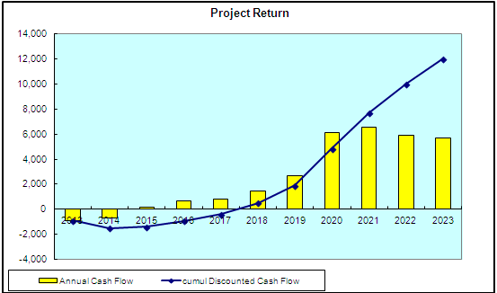
Project Profitability Estimation
Consumptions
TER target (TBD)
NSP Target (TBD)
* SE will sell M80 in project mode, there is no break down price for each product
* As an input of Onyx, we use 350EUR for NSP.
* TER and NSP will be provided later, when we launch these references to all countries.
CCV target (OTM estimation)
BMKC18332F 145 €
BMKC18332F4M 176 €
Some positive impacts not included in Onyx
Improve project price flexibility
Improve probability of winning bid
Directly pull through
- Upstream SCS system
- MV, LV Devices
- Service and consultant
Profitability (w/o pull through)

Slide 24
Project Risks
[High] Tight schedule for TTM (CSP project bid timeline)
Clear scope (CSP only for PMP M80)
Maximum reuse and just enough (OTM architecture, developed products/modules)
Good sync inside and outside project
[High] SW resource availability
Define a good scenario to consider constrains from M580 & Momentum unity project
(Unity V8.1 or V9?)
[Medium] Platform/common firmware strong related with Momentum unity/M580
Define firmware development strategy and SCM plan
Keep closely sync with Momentum unity/M580
[Medium] SW & FW sync due to limited knowledge on system
Assign a system arch for facilitating SW & FW sync
[Medium] FG MFG plant is assumed in WPF and most supplier in China, if choose SEMB or Carros will impact VA, CL2 and COGS increasing
Define Indus strategy as early during Eric’s visit to AOCC

Slide 25
Next Steps
SW/FW development scenario definition
OR analyze
Key point list and following before SELECT
[MKT] CSP project pipeline
[MKT] Software requirements – customer view
[R&D] Performance – system view
[R&D] HSC implementation – function, cost and performance view
[PJT/R&D] MSU(massive software upgrade) feasibility
[R&D] Cyber security impact
[R&D] Triangle vents evaluation on soft tooling
[Indus] Industrialization/manufacturing scenario
PCO update
PS kick off

Slide 26
CPU FW Arch

Slide 27
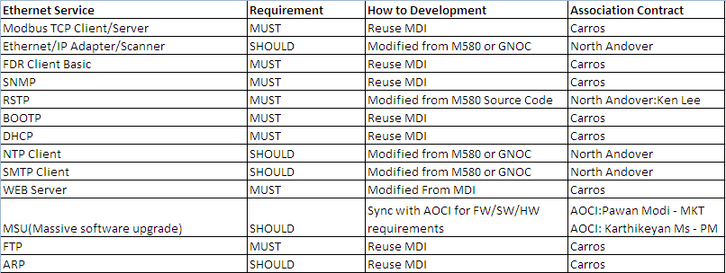
ETH Service

Slide 28
Decision

Slide 29
Stage Gate Synthesis
Risk assessment of the stage gate | % of progress of the deliverables | General comments
Major
99%
100%
80%
60%
0%
Minor
No risk
1. Need to further check system arch and techpub resource before SELECT
2. Define key point list before SELECT

Slide 30
PSC Approval for Open
Who | Role
Jiajun Mo | AOCC Plant Solution R&D Manager
Haidong Chen | AOCC PMO
Ming-Jeremy Yang | AOCC Quality Manager
Ming-Allen Sun | AOCC Industrial Manager
Janice Tang | AOCC OCP Purchasing Manager
Sylvain Olier | AOCC Marketing Manager
Guanhong-Grace Wang | Plant Solution PMO
Antonio Chauvet | Plant Solution R&D director
Franck Dery | Plant Solution SW manager
Decision
Open is approved with the following actions. A1: Leo, Ketty >> Will provide Delta PLC and VSD datasheet to see where is cost saving opportunity. A2: Leo, Ketty >> Will check 40 nodes per sub ring using RSTP A3: Leo, Ketty >> Will check 50ms again for M80 RSTP recovery time A4: Antonio Chauvet >> Assign a system architecture resource for M80 A5: Robin >> Find out techpub resource A6:Taylor >> Define manufacturing location with project level risk consideration before SELECT A7:Robin >> Organize a dedicated sync meeting including FW/SW to further clarify about I/O vision and explicit exchange etc. A8: Robin >> Hold sync meeting with AOC-I MSU team for project and technical discussion (cost, schedule, technical risks etc.) A9:Jianson >> Will evaluate Ethernet/IP's impact on FW/SW and make decision before SELECT A10:Team >> Define key point list especially in terms of customer/application view before SELECT
Legend
Stage gate is approved without restriction.
Stage gate is refused. Second chance to pass the stage gate is given to the project manager.
Stage gate is refused. Project is stopped.
If you can read this text, please change the background color of the sheet in PowerPoint.

